Slide 1
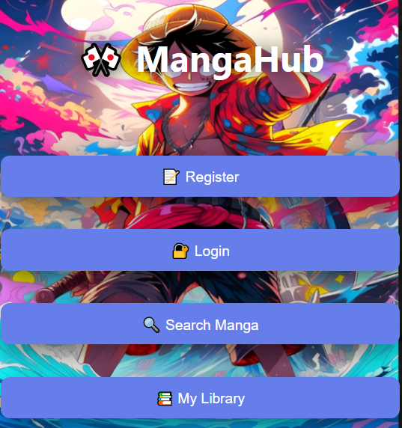
MANGAHUB
Group Members:
Nguyễn Anh Quân (ITITIU22129)
Đặng Huỳnh Minh Phúc (ITITIU22126)
Instructors:
Dr. Le Thanh Son
MSc. Nguyen Trung Nghia

Slide 2



Project Overview & Objectives
MangaHub isn't just a library; it's a technical showcase of how different communication standards can coexist to solve specific architectural needs in a modern web application.
Library Management
Real-Time Sync
Community Hub
Full CRUD operations for managing manga collections and personal reading progress tracking.
Instant broadcasting of progress updates across all connected clients using multiple protocols.
A high-performance chat system featuring multiple themed rooms and typing indicators.
Our primary objective was to implement HTTP, TCP, UDP, WebSocket, and gRPC within a single, cohesive Go-based ecosystem.

Slide 3
System Architecture & Port Mapping
Main Web & API
HTTP/REST
8080
Progress Broadcaster
TCP
9090
Fast Notification
UDP
9091
Microservice Interface
gRPC
9092
Real-time Chat
WebSocket
9093

Slide 4
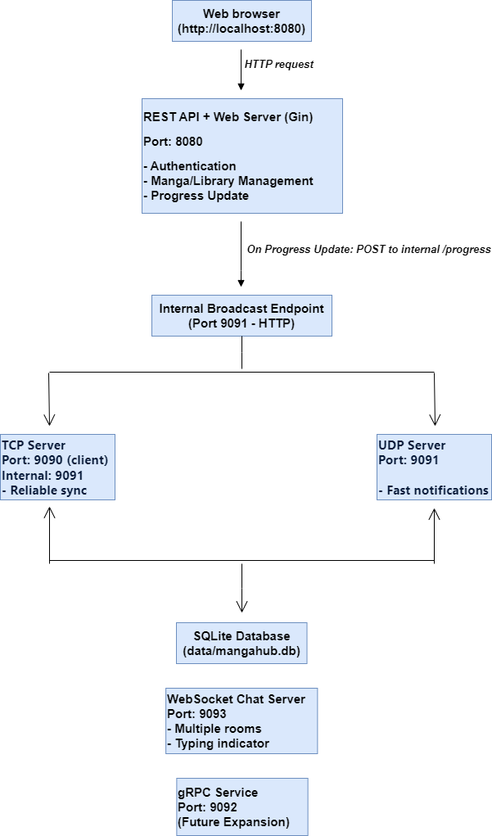
System Architecture & Port Mapping
Web Browser
URL: http://localhost:8080
Sends HTTP requests
gRPC Service
Port: 9092
REST API + Web Server (Gin)
Port: 8080
Handles:Authentication
Manga/Library Management
Progress Update
WebSocket Chat Server
Port: 9093
Features:
Multiple rooms
Typing indicator
TCP Server
Port: 9090 (client)
Internal: 9091
Provides reliable sync
SQLite Database
File path: data/mangahub.db
On Progress Update:
POST to internal /progress
Internal Broadcast Endpoint
Port: 9091 (HTTP)
UDP Server
Port: 9091
Sends fast notifications

Slide 5
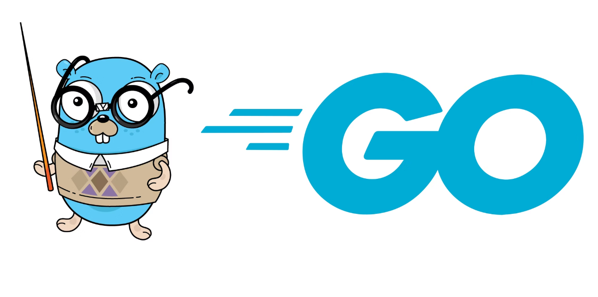
Technology Stack & Tooling
Language: Go (Golang)
API Framework: Gin
Utilized Goroutines for lightweight thread management across five servers.
A high-performance HTTP web framework used for our RESTful endpoints.
Persistence: SQLite
WebSocket: Gorilla
A lightweight, serverless SQL engine perfect for local development and portability.
Documentation: Swagger
Frontend: Vanilla JS/CSS
Testing: Postman & Telnet

Slide 6
The Core: HTTP REST API
The REST API serves as the primary gateway for user interactions,
providing secure and documented endpoints for the frontend.
Interactive Docs
Using Swaggo, we generated a full Swagger UI at /swagger/index.html for live API testing.
Secure Auth
Implemented JWT (JSON Web Tokens) to protect user-specific data and library progress.
When a user updates their reading progress via a POST request, the API triggers a broadcast event that is propagated to our TCP and UDP listeners.

Slide 7
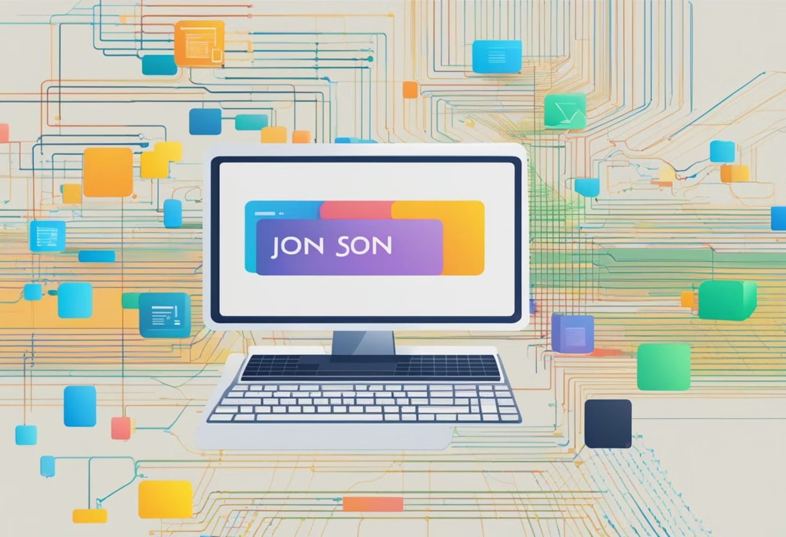
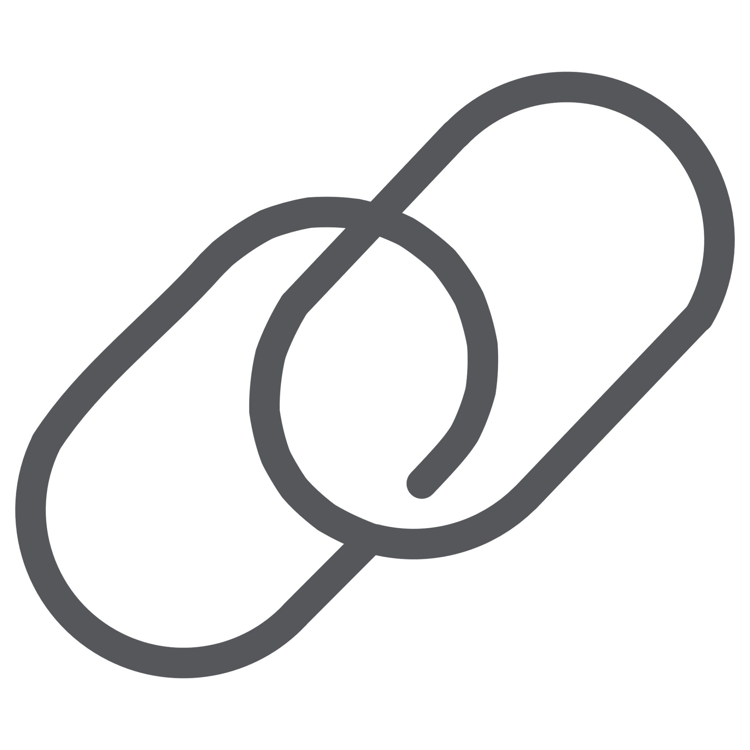

Reliable Sync: TCP Protocol
Protocol Features
Connection-Oriented
Ensures a stable link between the server and the client.
Data Integrity
Guarantees that progress updates arrive intact
and in order.
Demonstration: By connecting via telnet localhost 9090, users receive immediate JSON notifications the moment a web update occurs.

Slide 8
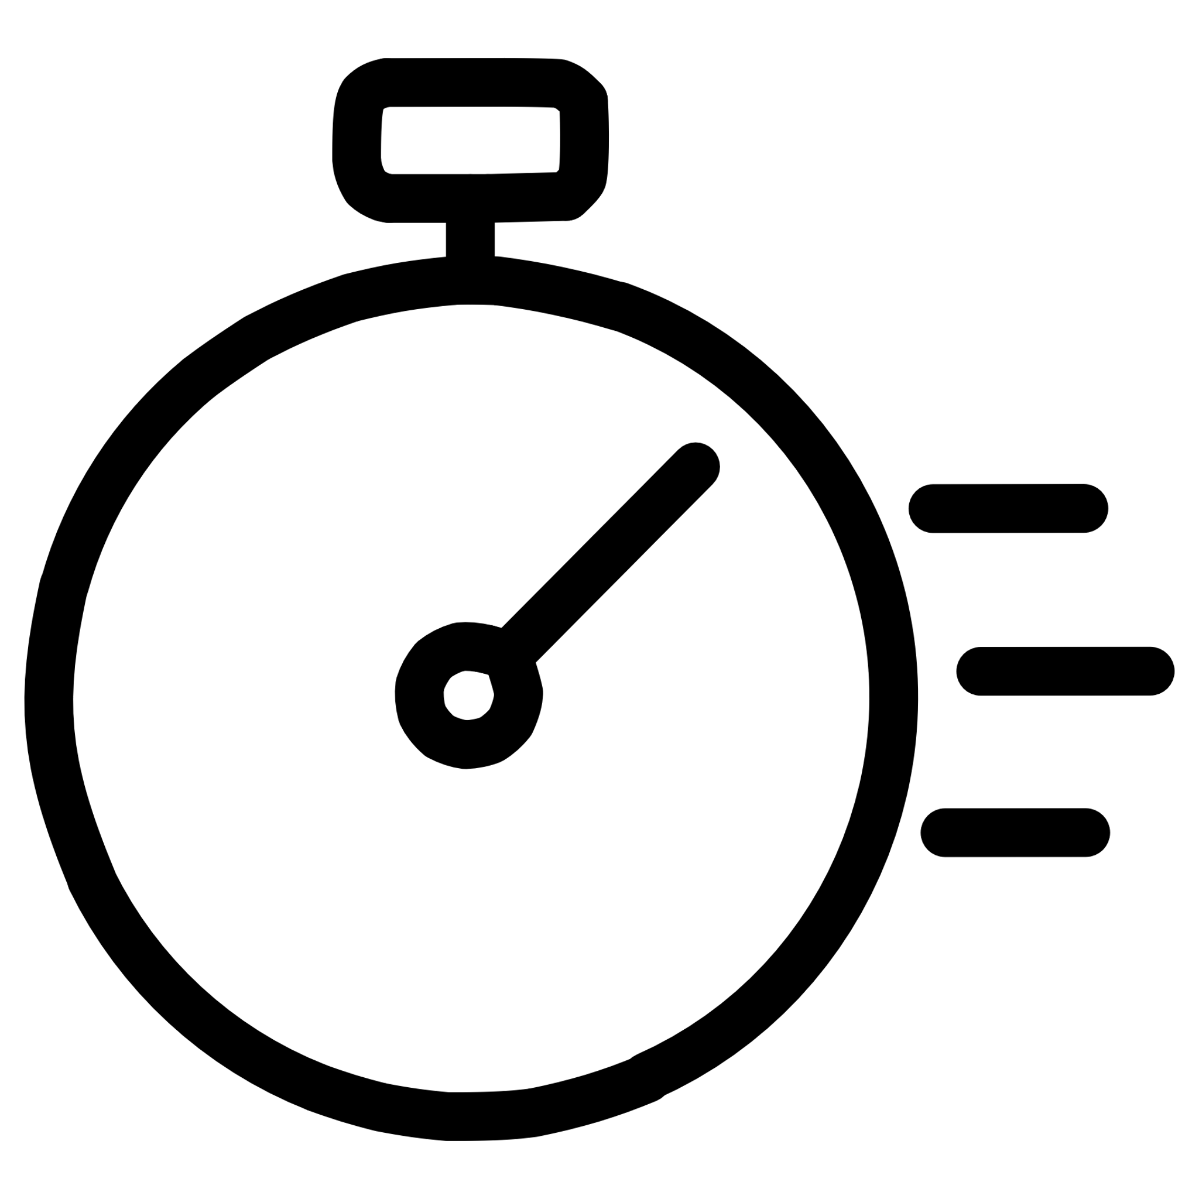

Notifications: UDP
UDP is utilized for low-latency notifications where speed is prioritized over guaranteed delivery, mimicking real-world mobile push notification systems.
Minimal Overhead
Best-Effort Delivery
No handshake or connection maintenance, reducing battery and data usage for mobile clients.
Perfect for "fire-and-forget" updates where the next update will soon replace the current one.
Our custom UDP client listens on port 9091. It captures the broadcast packets sent from the main API, demonstrating sub-millisecond propagation of user activity.

Slide 9
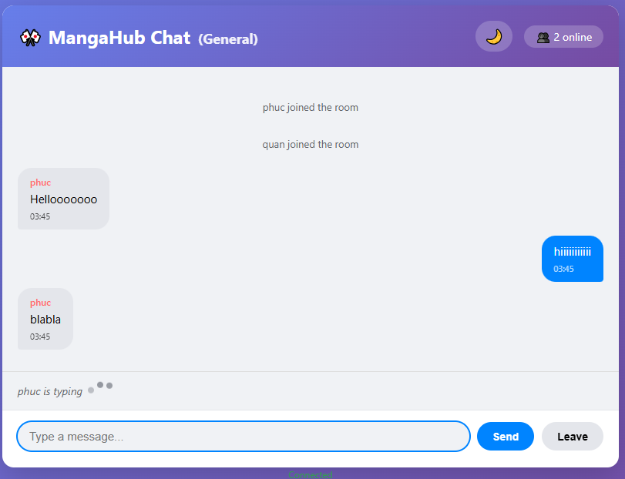

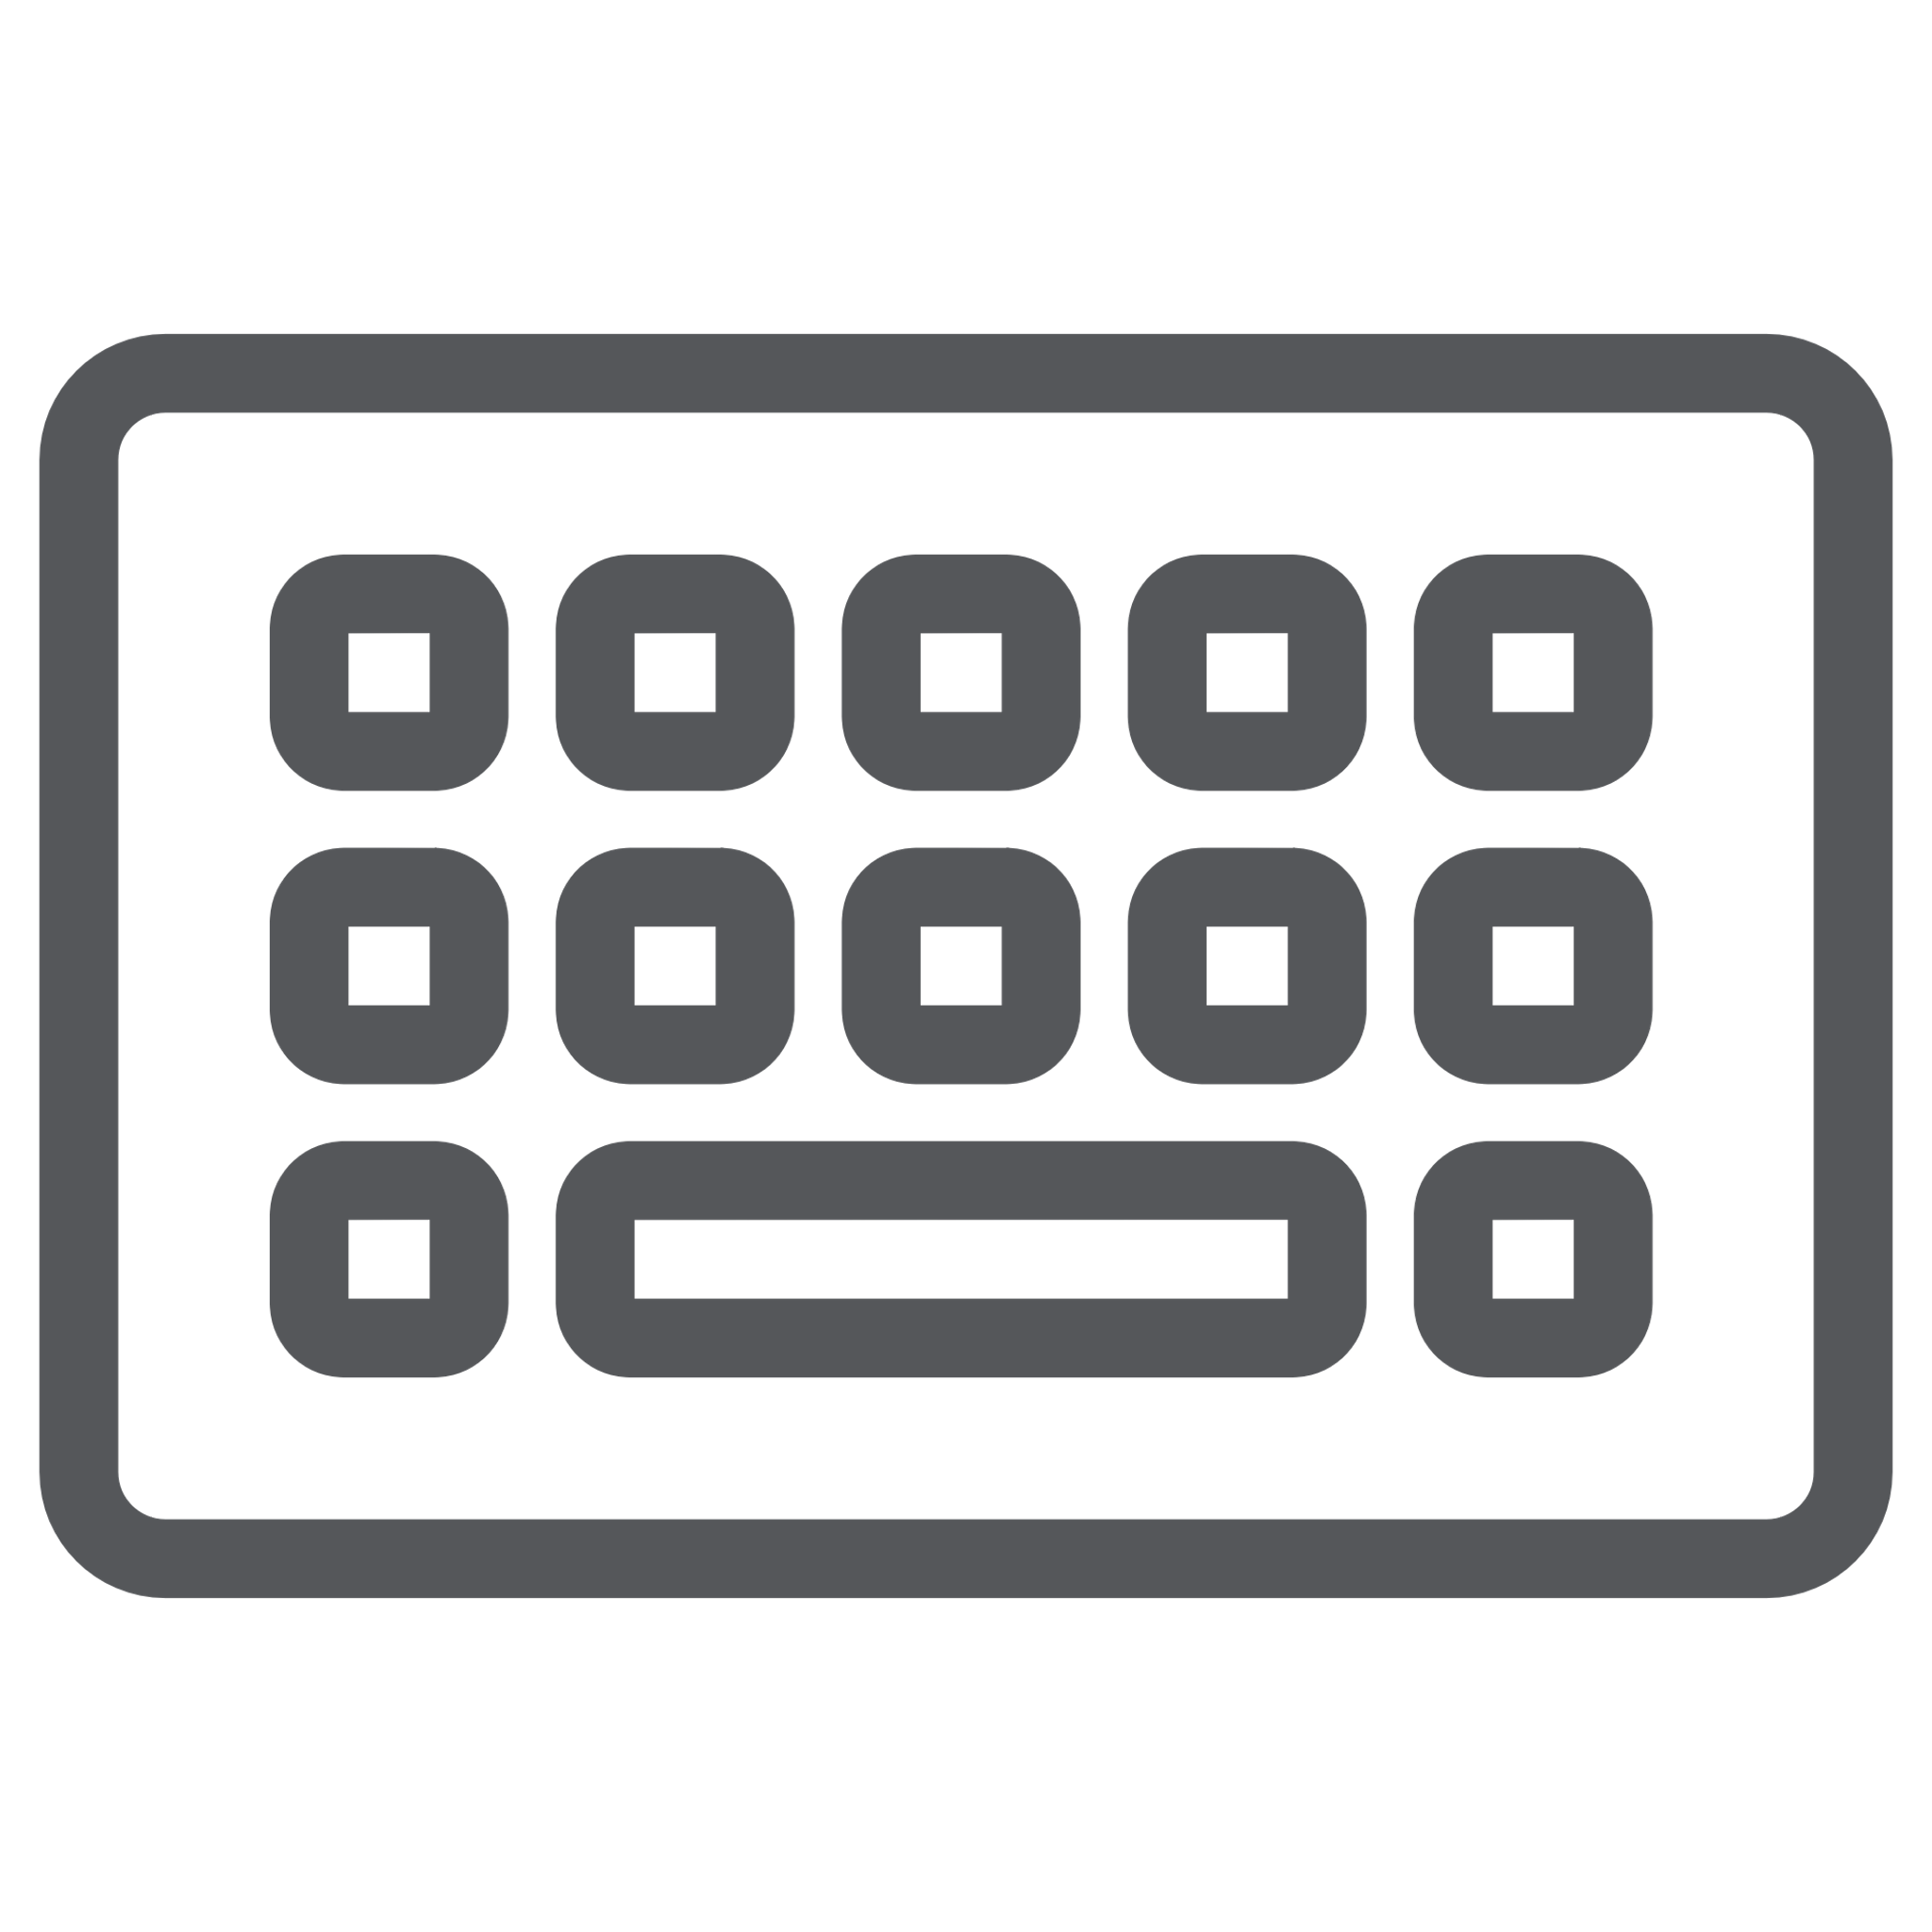

WebSocket:
Multi-Room Chat
Room Isolation
Typing Indicators
State Persistence
Users can join specific "Manga Rooms" (e.g., One Piece, Naruto). Messages are filtered so they only reach the relevant audience.
State management tracks when users are typing, providing a modern "social" feel to the interface.
Join/Leave notifications and message history are handled seamlessly through the WebSocket hub.

Slide 10
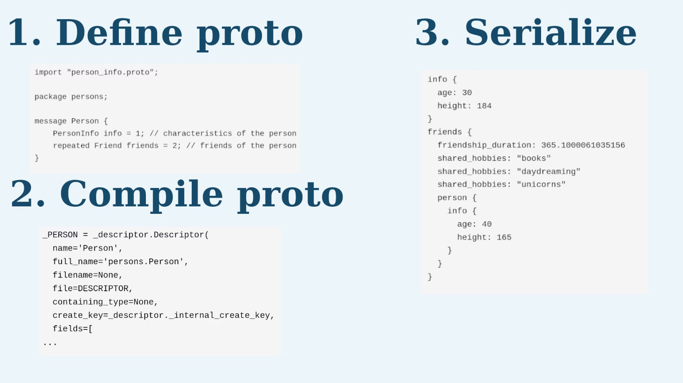
gRPC & Code Documentation
gRPC Microservices
Professional Docs
We defined a .proto contract on port 9092, allowing high-performance, language-agnostic communication with future services like a recommendation engine or an external scraper.
Swagger: Detailed API specs for frontend developers.
GoDoc: Internal documentation accessible via godoc -http=:6060 for every function and struct.

Slide 11

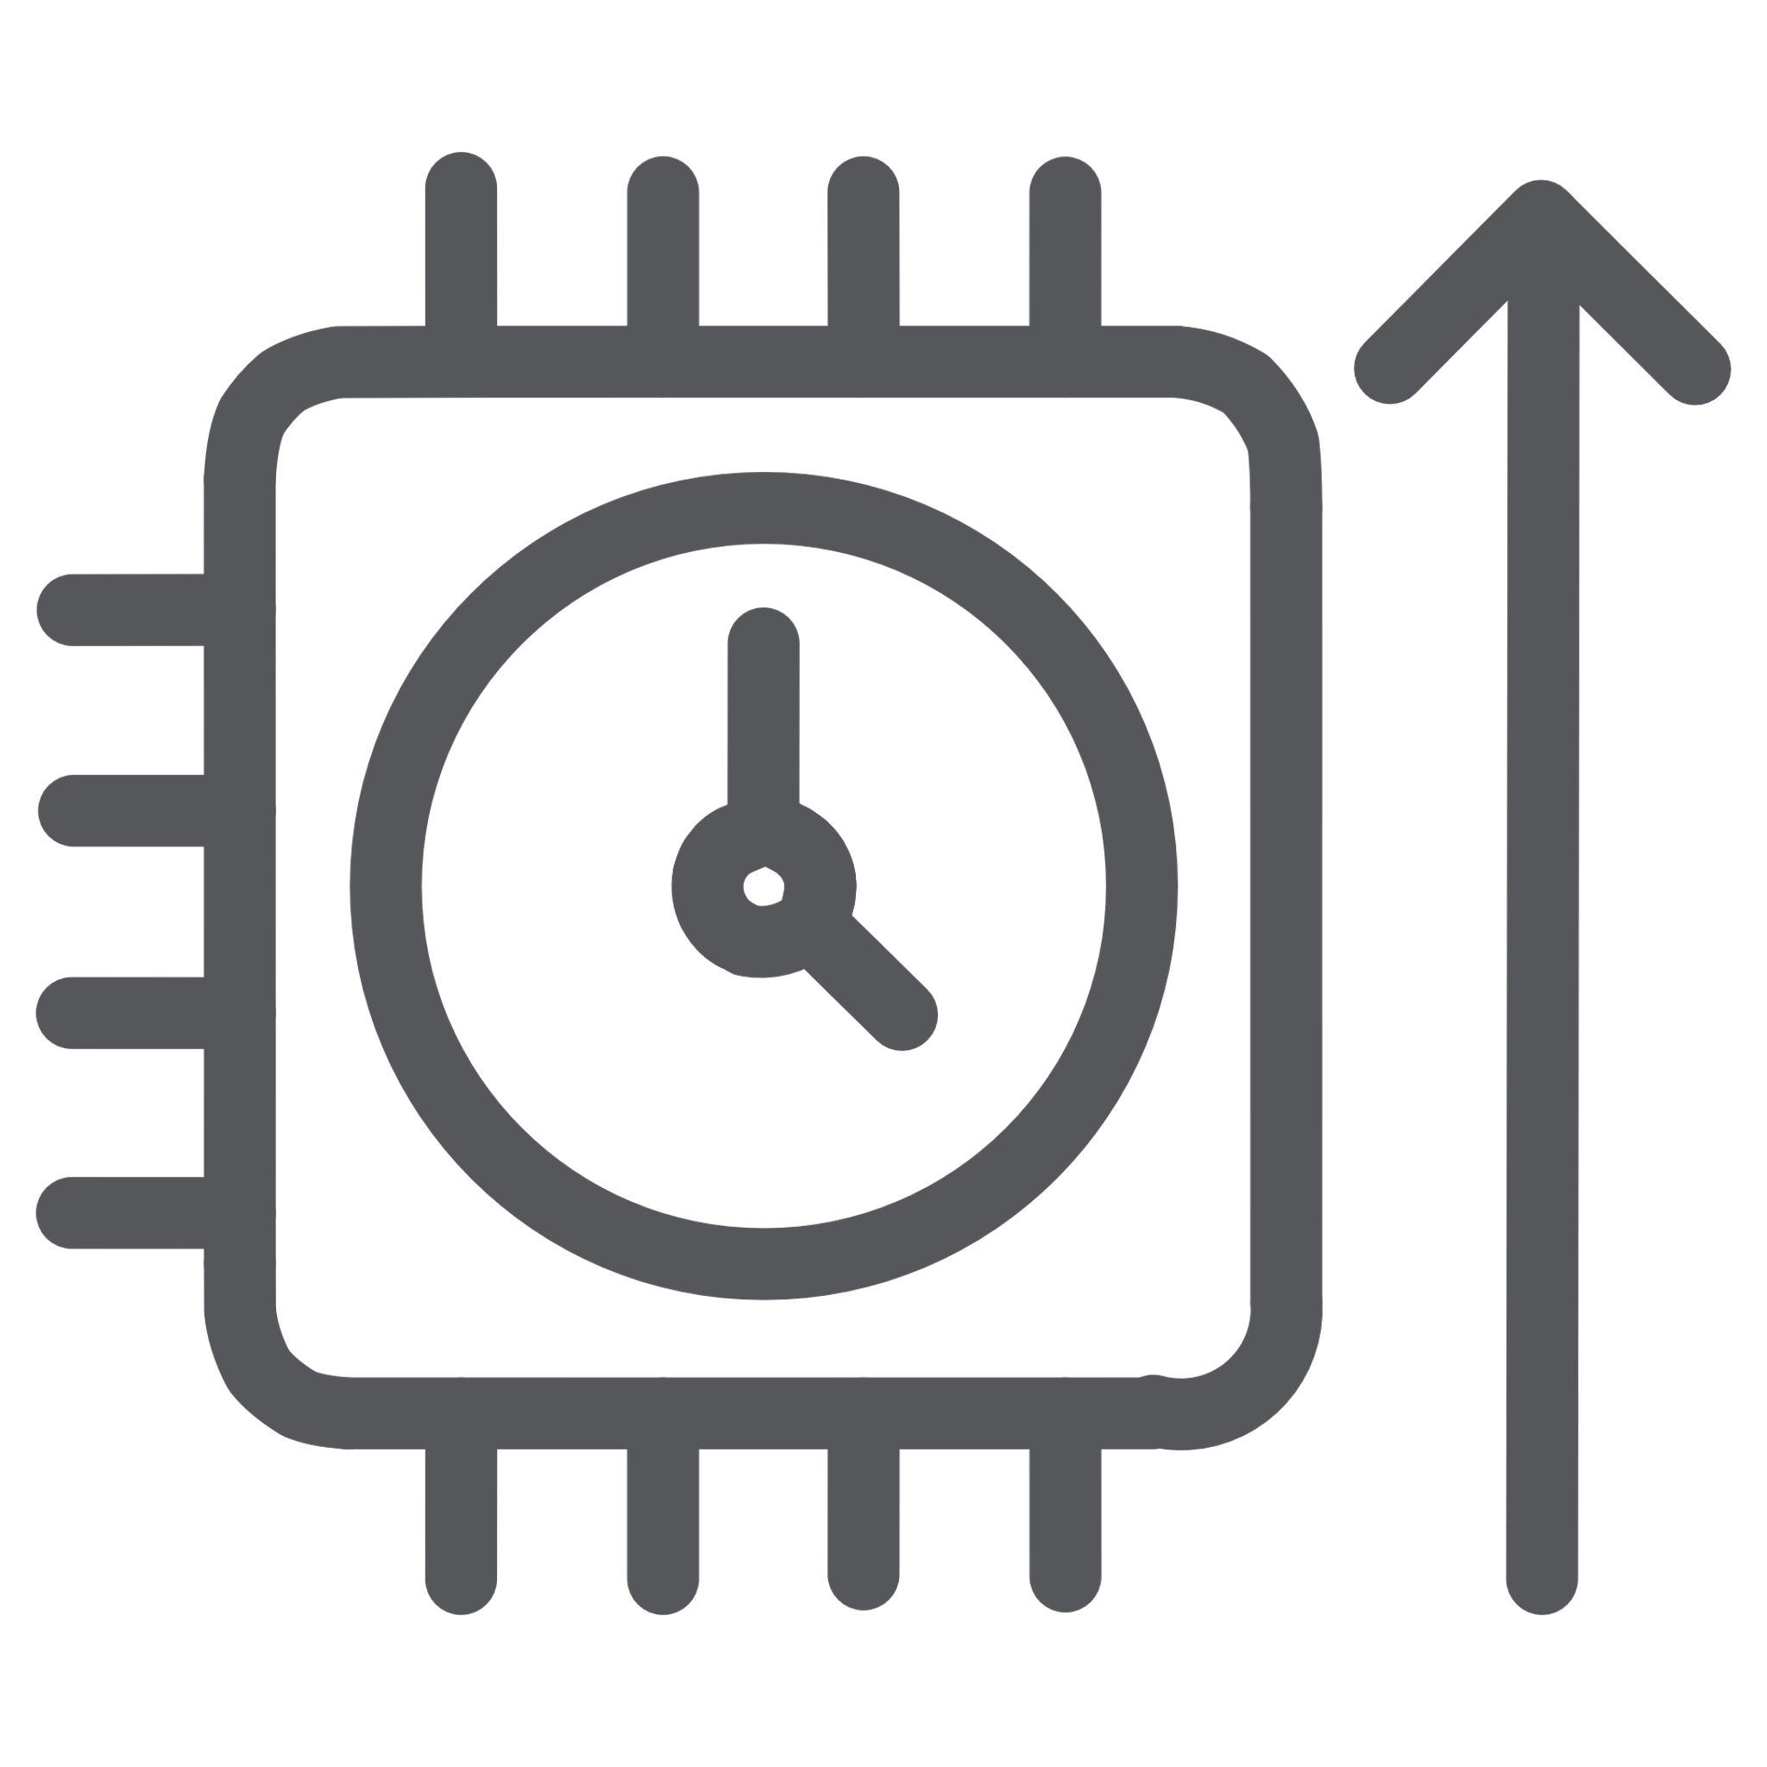

Reflections & Conclusion
Building MangaHub provided invaluable insights into the trade-offs of modern networking.
Final Verdict
Concurrency
MangaHub stands as a robust, production-ready demonstration of Net-Centric programming.
Integration
Mastered Go's Mutexes and Channels to ensure thread-safe progress updates.
Learned to synchronize five different servers through a shared internal state.
Thank you for your attention!
We are now open for any questions regarding our architecture or protocol implementations.

Slide 12

Q&A

Slide 13
Live Demo

